Slide 1
KIVA LOAN ANALYSIS

Slide 2
HISTORY
Kiva partners around the world (September 2006) . Kiva was founded in October 2005 by Matt Flannery and Jessica Jackley. The couple's initial interest in microfinance was inspired by a 2003 lecture given by Grameen Bank's Muhammad Yunus at Stanford Business School.
In April 2005, Kiva's first seven loans were funded, totaling $3,500, and the original entrepreneurs were subsequently deemed the "Dream Team. By September 2005, the entrepreneurs repaid the entirety of their original loans, and the founders realized they had developed a sustainable microcredit concept.

Slide 3

INTRODUCTION
Kiva Microfunds (commonly known by its domain name, Kiva.org) is a non-profit organization that allows people to lend money via the Internet to low-income entrepreneurs and students in over 80 countries. Kiva's mission is "to connect people through lending to alleviate poverty.
Kiva relies on a network of field partners to administer the loans on the ground. These field partners can be microfinance institutions, social businesses, schools or non-profit organizations. Kiva includes personal stories of each person who needs a loan because they want their lenders to connect with their entrepreneurs on a human level.

Slide 4
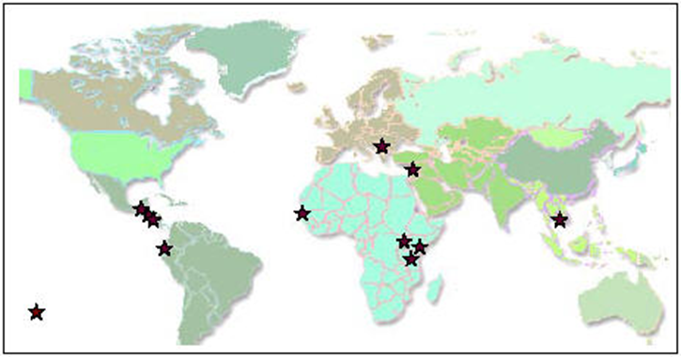
1. Kiva partners around the world (September 2006)

Slide 5
FINANCE
Kiva itself does not charge interest rates on its loans; they supply capital to microfinancing institutions for free. These microfinancing institutions then lend out money with high interest compared to bank finance in mature markets, averaging a portfolio yield of over 30%.[21] The organization's main sources of funding are grants, financial backing, and discounted services from many major national corporations and institutions
$827,356,850 loan given to

Slide 6
Problem Statement
For the locations in which Kiva has active loans, our objective was to pair Kiva's data with additional data sources to estimate the welfare level of borrowers in specific regions, based on shared economic and demographic characteristics.

Slide 7
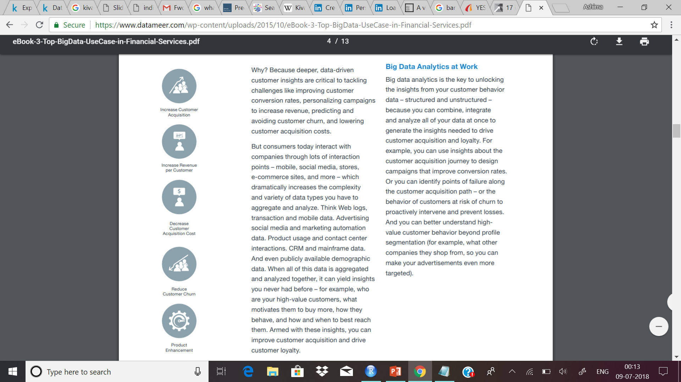
Big data
Big data analytics is the key to unlocking the insights from your customer behavior data – structured and unstructured – because you can combine, integrate and analyze all of your data at once to generate the insights needed to drive customer acquisition and loyalty.
For example, you can use insights about the customer acquisition journey to design campaigns that improve conversion rates. Or you can identify points of failure along the customer acquisition path – or the behavior of customers at risk of churn to proactively intervene and prevent losses. And you can better understand high value customer behavior beyond profile segmentation (for example, what other companies they shop from, so you can make your advertisements even more targeted).

Slide 8
Preferred Tools For Project
For DATA STORAGE
HADOOP
HIVE
APACHE PIG
R
For VISUALISATION
PYTHON

Slide 9

What is R
R is a programming language and software environment for statistical analysis, graphics representation and reporting. R was created by Ross Ihaka and Robert Gentleman at the University of Auckland, New Zealand, and is currently developed by the R Development Core Team.

Slide 10

What is PYTHON
Python is a high-level, interpreted, interactive and object-oriented scripting language. Python is designed to be highly readable. It uses English keywords frequently where as other languages use punctuation, and it has fewer syntactical constructions than other languages.
Python was developed by Guido van Rossum in the late eighties and early nineties at the National Research Institute for Mathematics and Computer Science in the Netherlands.
Python is derived from many other languages, including ABC, Modula-3, C, C++, Algol-68, SmallTalk, and Unix shell and other scripting languages.

Slide 11

What is Apache Hadoop
Apache Hadoop is an open source software framework for storage and large scale processing of data-sets on clusters of commodity hardware .
Large datasets : Terabytes or petabytes of data
Large clusters : hundreds or thousands of nodes
Hadoop is the open-source implementation for Google MapReduce
Hadoop was created by Doug Cutting and Mike Cafarella in 2005 and named the project after son's toy elephant

Slide 12

What is HIVE
An SQL-like interface to Hadoop
Data Warehouse infrastructure that provides data summarization and ad hoc querying on top of Hadoop.
Facilitates querying and managing large datasets residing in distributed storage.
Enables data warehousing tasks such as extract/transform/load (ETL), reporting and data analysis
Provides a mechanism to project structure onto this data.

Slide 13

What is APACHE PIG
Apache Pig is an abstraction over MapReduce. It is a tool/platform which is used to analyze larger sets of data representing them as data flows. Pig is generally used with Hadoop; we can perform all the data manipulation operations in Hadoop using Apache Pig.
In 2006, Apache Pig was developed as a research project at Yahoo, especially to create and execute MapReduce jobs on every dataset. In 2007, Apache Pig was open sourced via Apache incubator. In 2008, the first release of Apache Pig came out. In 2010, Apache Pig graduated as an Apache top-level project.

Slide 14


Apache Pig Vs Hive
Apache Pig uses a language called Pig Latin. It was originally created at Yahoo.
Pig Latin is a data flow language.
Pig Latin is a procedural language and it fits in pipeline paradigm.
Apache Pig can handle structured, unstructured, and semi-structured data.
Hive uses a language called HiveQL. It was originally created at Facebook.
HiveQL is a query processing language.
HiveQL is a declarative language.
Hive is mostly for structured data.

Slide 15

WE USED
For DATA STORAGE
HADOOP
HIVE
PYTHON
For VISUALISATION

Slide 16
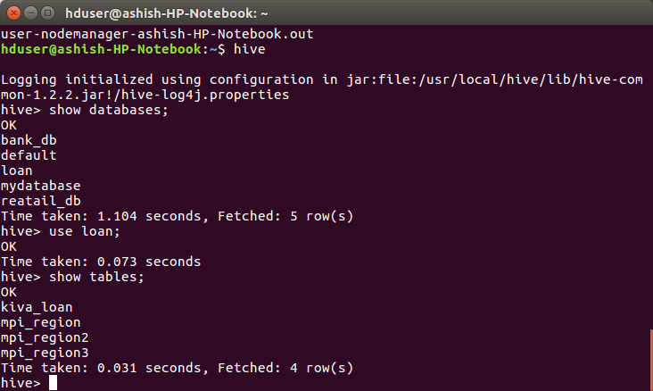

Slide 17
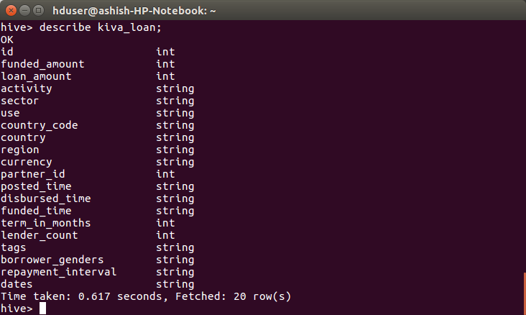

Slide 18
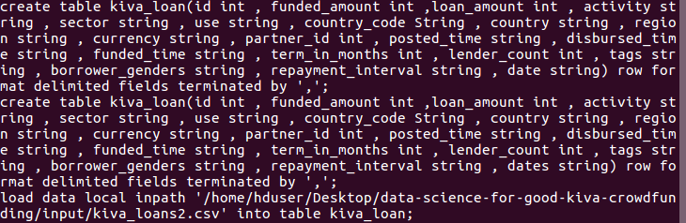

Slide 19
COUNTRIES WHERE KIVA NEEDS PROMOTIONS

Slide 20
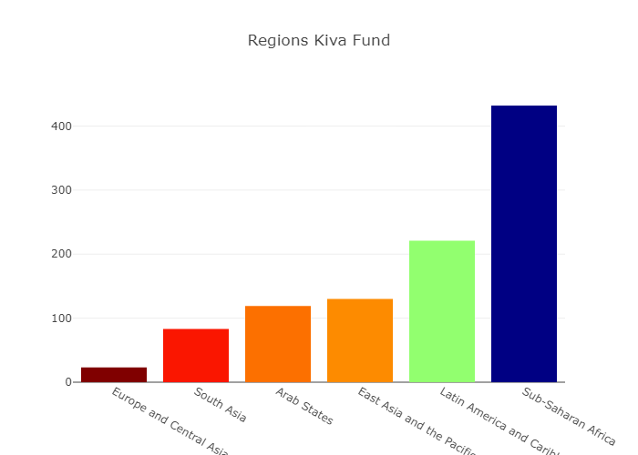

Slide 21
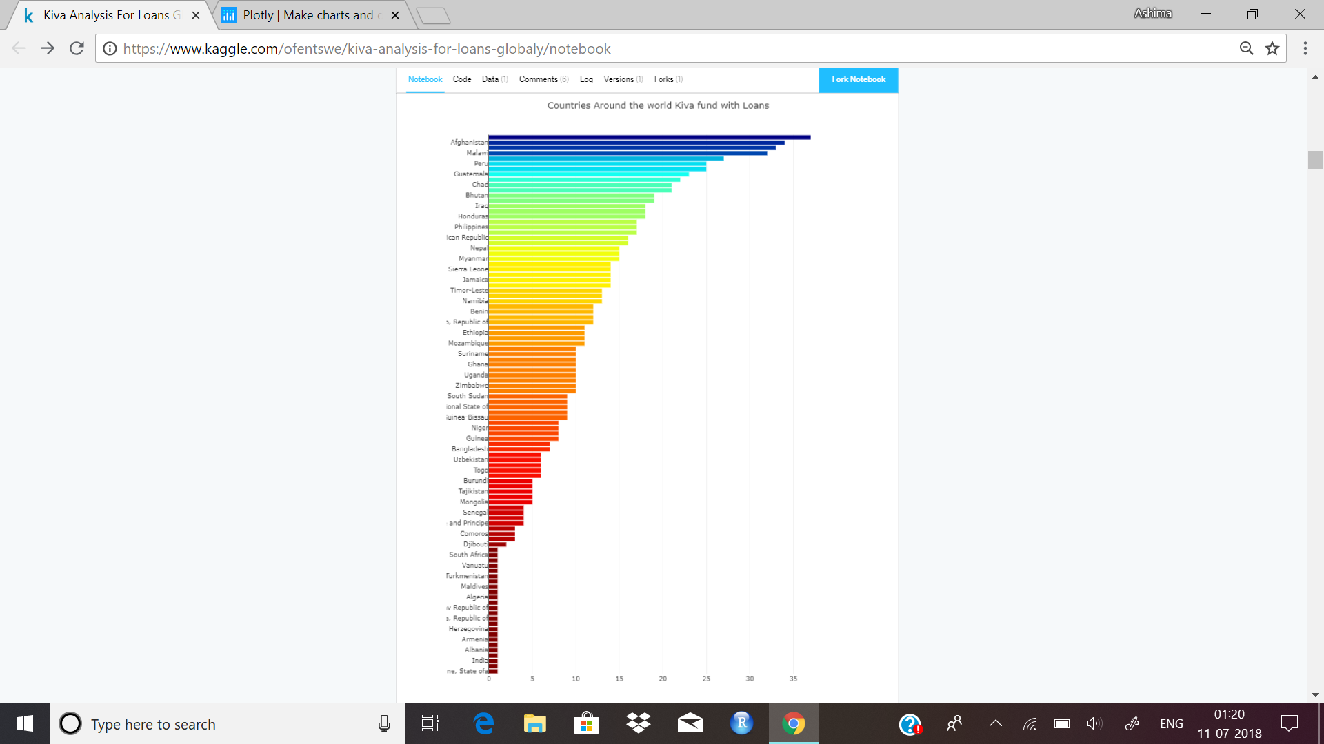

Slide 22
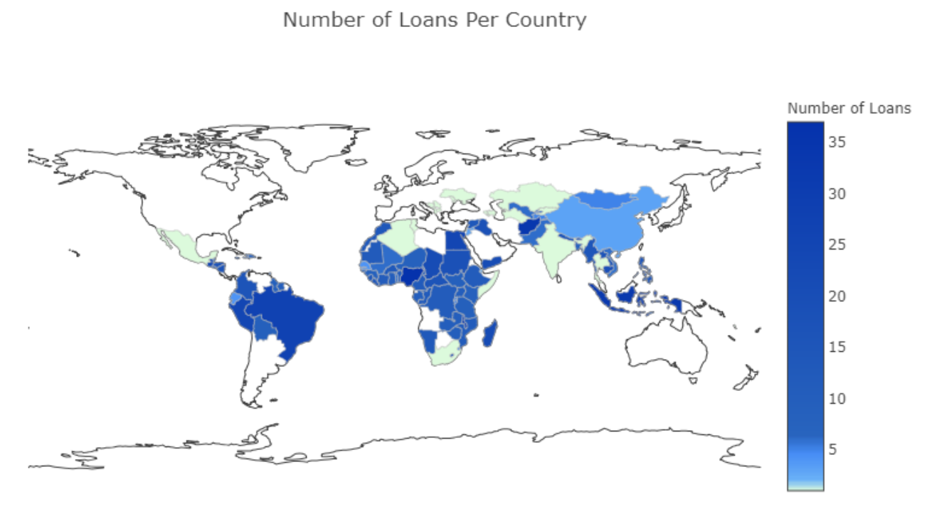

Slide 23
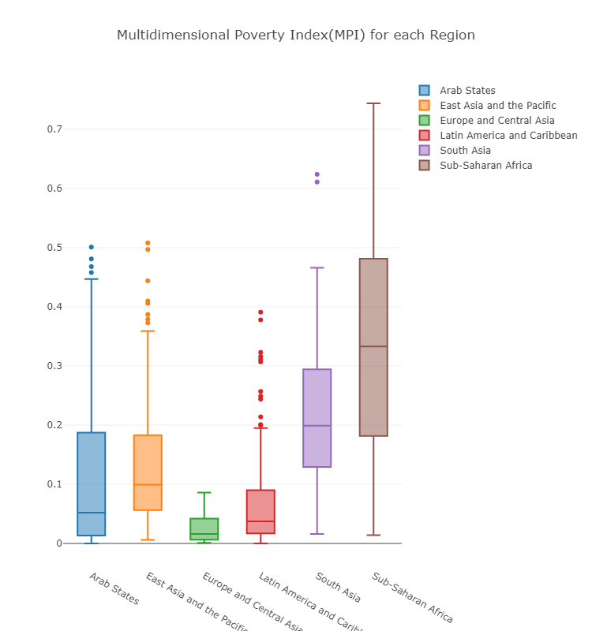

Slide 24
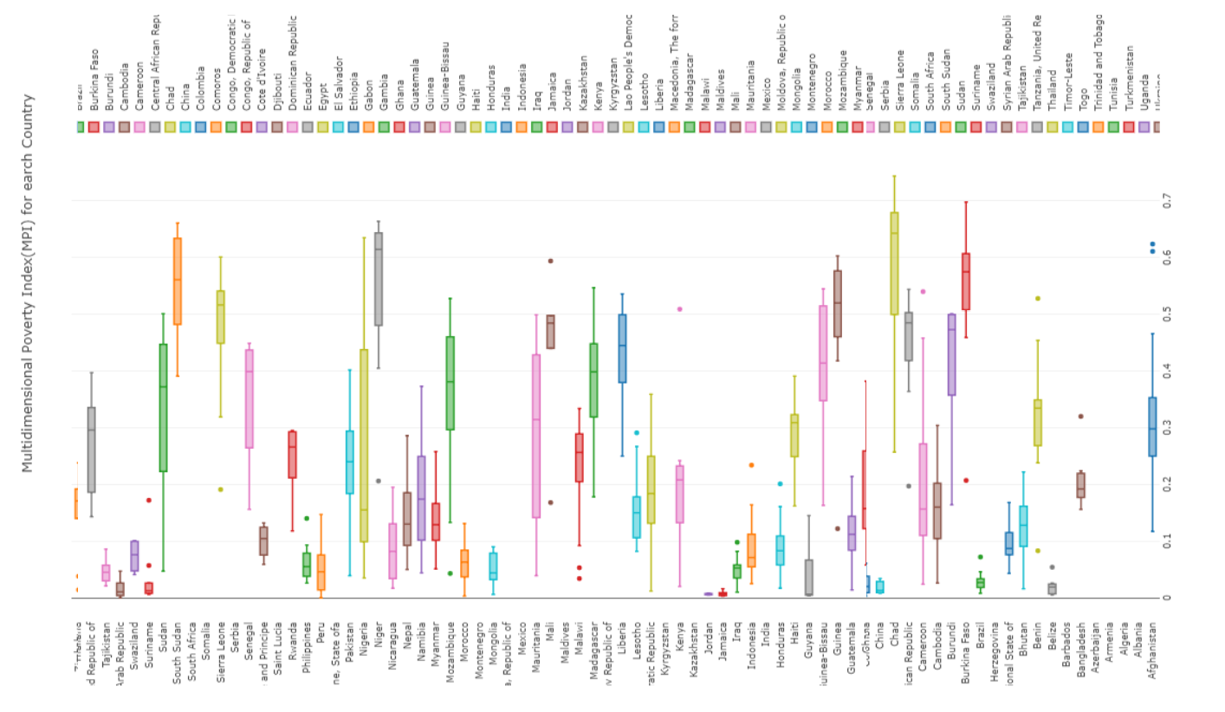

Slide 25
From the above analysis we get to know that kiva needs to promote itself more in the countries like algeria, somalia and saudi arabia

Slide 26
WHICH SECTOR IS GROWING?

Slide 27
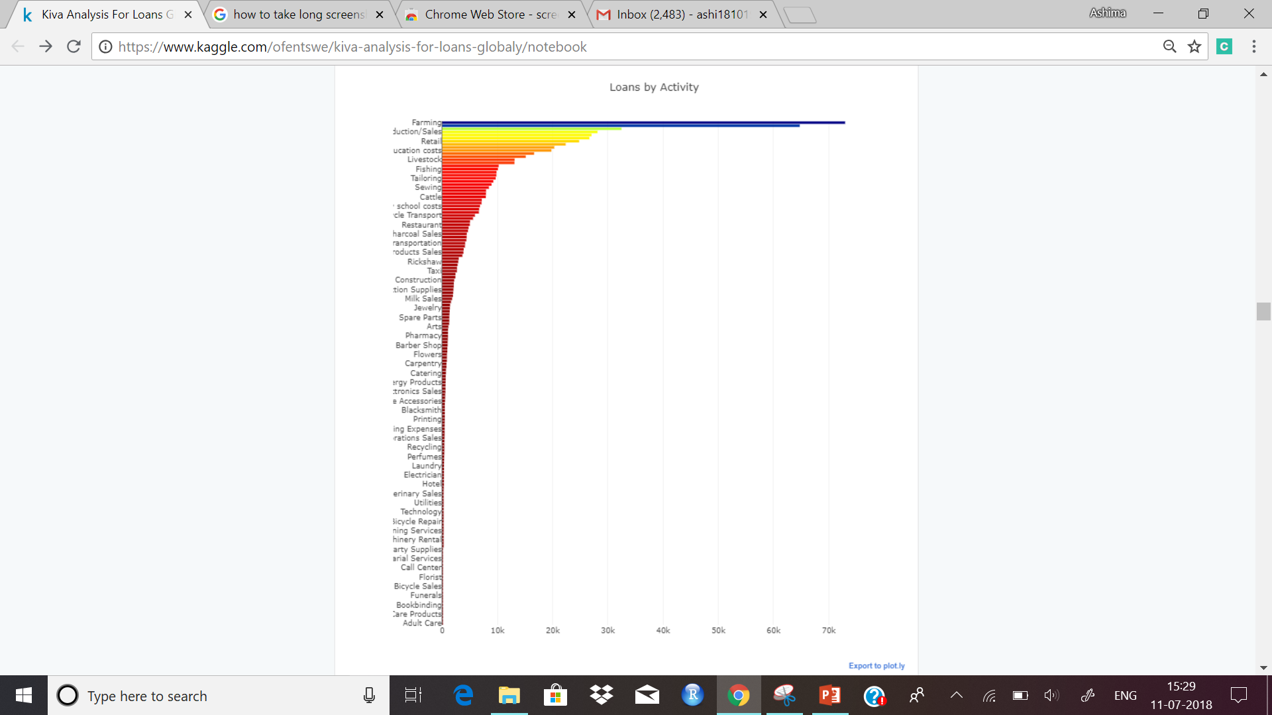

Slide 28
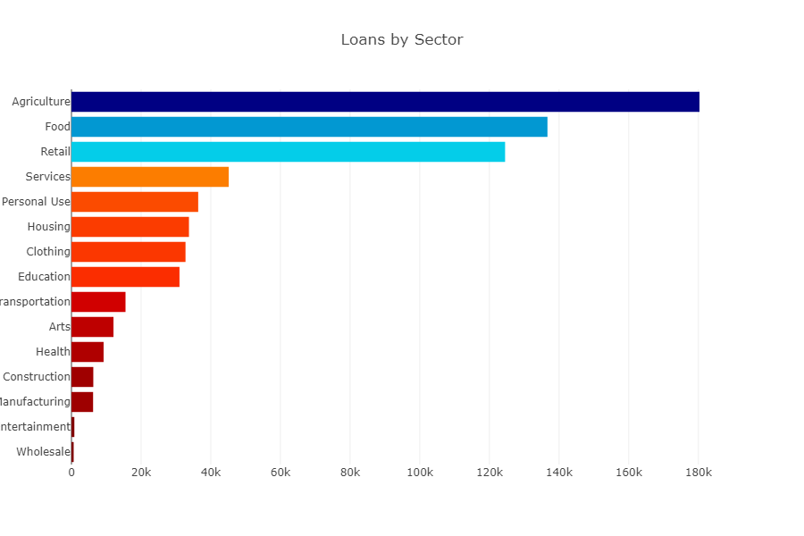

Slide 29
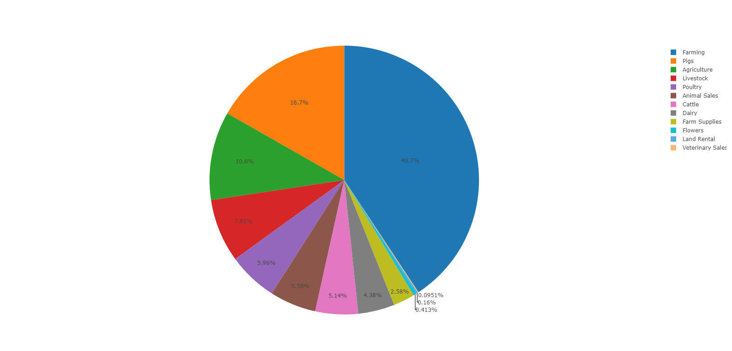
Agriculture

Slide 30
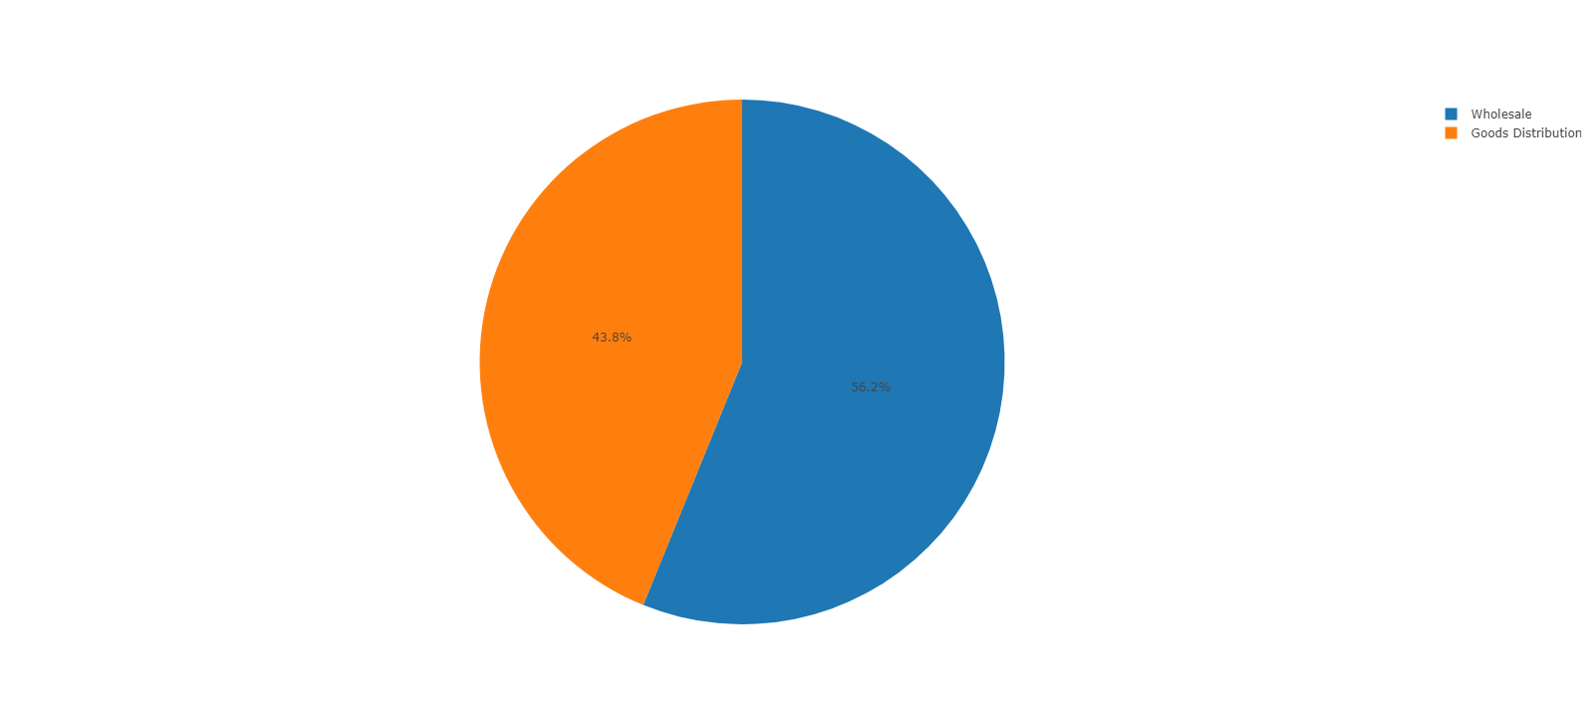
WHOLESALE

Slide 31
Agriculture Sector is growing Fastest

Slide 32
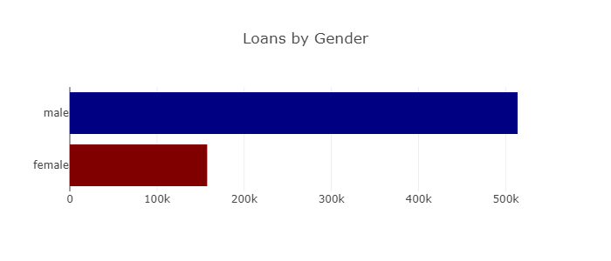

Slide 33
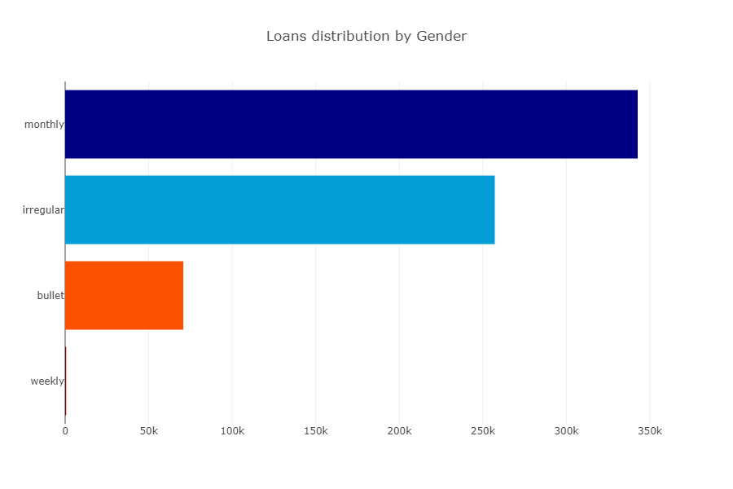

Slide 34
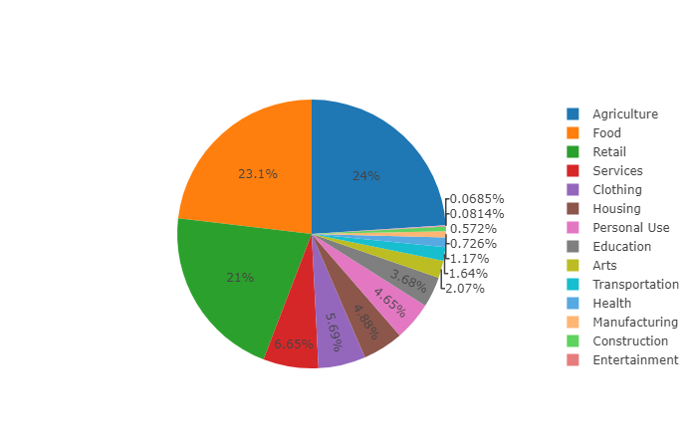
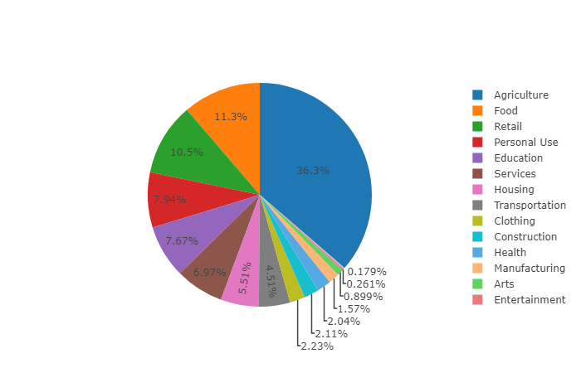
MEN SECTOR VS WOMEN SECTOR

Slide 35
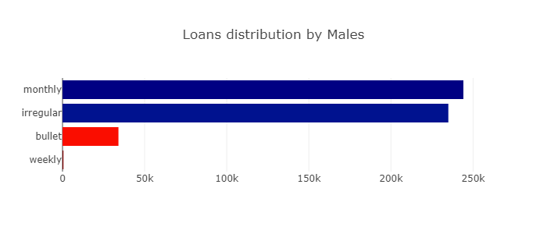
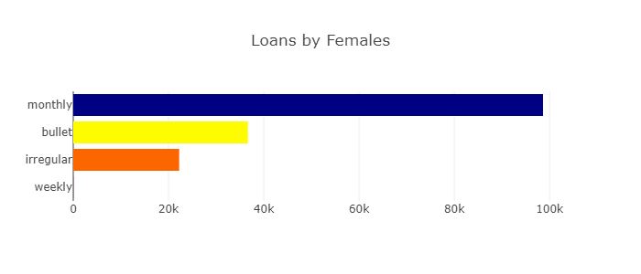

Slide 36
THANK YOU

